Slide 1
This slide is intentionally left blank.
Only add finance, investment concepts to this slide!
About the implementation, refer to another repo “StockCracker”.

Slide 2
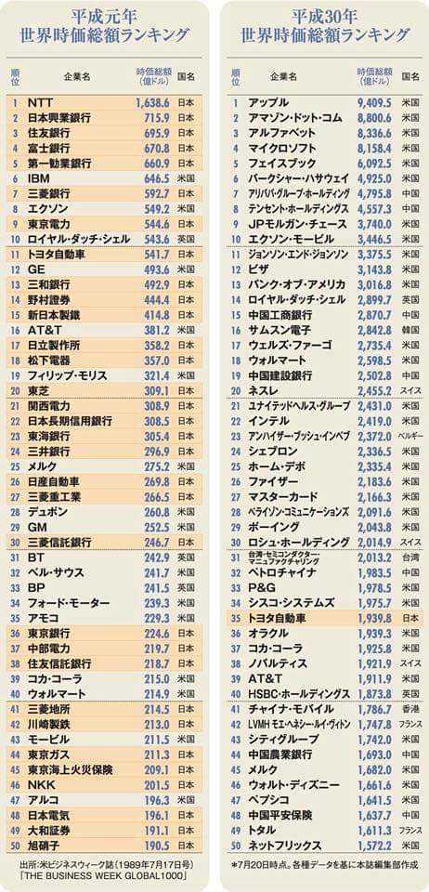
2018.08.22
逛facebook的时候偶然发现了右图，感觉很有意思
查了一下「世界時価総額ランキング」, 感觉对股票投资有指导作用
Yahoo Finance也是很好的参考(https://info.finance.yahoo.co.jp/ranking/?kd=4&mk=1&tm=m&vl=a), 这里提供了各只股票的 发行量x时价=時価総額
2018.08.27
拿到Google Offer了，但感觉有点低…
或说Google的compensation package里面有一个叫restricted stock unit (RSU)的东西(期间12个月，12 month vesting)，这个东西查了一下是啥
首先vesting的意思：Vesting is a legal term that means to give or earn a right to a present or future payment, asset or benefit.
然后RSU的：A restricted stock unit (RSU) is a compensation issued by an employer to an employee in the form of company stock. Restricted stock units are issued to an employee through a vesting plan and distribution schedule after achieving required performance milestones or upon remaining with their employer for a particular length of time.
用自己的话总结一下就是，公司可以给我股票，但我必须先工作12个月才能拿到这12个月的股票
2018.08.28
查了更多的compensation中stock的种类
Stock option:
The right to buy a company’s stock at some future date at a price established now.
High-growth company的话，会很划算，比如在未来公司股票100元的时候，以现在的价钱10元购买
Restricted stock:
Stock for which payment is usually not required. Simply common stock that vests. Can not sell until vest.
比如，就是公司同意在1年后给我100股，我必须干满1年才能拿到这100股(vest)，然后我可以决定卖掉或是继续持有
Restricted stock unit:
RSU can occur in stock or equivalent cash value of the company’s stock. (Google offer的是cash，这种情况下Google股价变化和我能拿到的钱没有关系)
我拿到的是Google同意在4年内，给我等同月4万多美元的RSU，每年可以vest 1万多美元，在vest之前，和Google股价无关，在vest的时候，我可以决定是卖掉或者是继续持有(就是把这1万多美元按当时的价钱换算成股票)。卖掉的情况下我一定能拿到这1万多美元；在持有的情况下，Google的股价就开始影响我了

Slide 3
My checklist before investing in stock market.
以下是一些著名investor的投资checklists，我应该参考这些然后work out我自己的list
(以下是Philip Fisher的list – Growth Investment)
一个公司的product/service有没有足够的market potential (有market potential是指在未来的几年中，此公司的product/service是否能有sizable increase in sales)
公司的management是否有决心去持续的投资并开发能带来total sales potentials增长的新的products or processes? 特别是当现在的主打product的potential已经被fully exploited的是时候
公司的R&D成果和其公司Size的比例是否够大(可以用R&D投资/成果和公司利益的比做评价)
公司是否有一个好的sales organization? (sales organization是专有名词，指公司里和profitability直接挂钩的，负责distribute goods to consumer的部门)
ToDo：怎样评价一个公司的sales organization？
公司是否有一个worthwhile profit margin?
ToDo：啥是profit margin? 咋样才能算是worthwhile?
公司是否在为了maintain / improve profit margins而努力? 怎样努力?
公司是否有outstanding labor and personnel relations?
ToDo: 怎样评价labor and personnel relations的好坏?
公司是否有outstanding executive relations? (我的理解是，executive relation是指一个公司的top和此公司的partner/customer公司的top之间的关系，可以归结到CEO和CEO之间的关系；此relation关系到一个公司是否被其customer认为是一个trusted partner that can shape the future together，还是仅仅是一个vendor that might be called later because of having competing price)
ToDo: 怎样评价executive relations的好坏？
公司是否有depth and talent in its management?
公司的cost analysis and accounting是否很好?
是否有其他证据能表明此公司在其involved industry中，非常outstanding?
公司是否有profit相关的short-range / long-range outlook?
在可预见的将来，公司是否需要大量股权融资，并且此融资会使现在的stockholder从公司growth中获得的利益减少很多?
ToDo: 这个怎么看?
当troubles和disappointment发生的时候，公司的management是否能和investors良好的交流?
公司的management是否有unquestionable integrity?
ToDo: 这个info怎么搜集?
(以下是Warren Buffet的checklist，Value invest)
Buy high quality business at cheap price (ignore short-term别担心短期股市up和down，关心business quality是不是好)
公司是否有great management
公司是否shareholder-oriented (从dividends和share-buy-back上看)
我是否理解公司在干什么，能不能用自己的话说公司从原材料购入到生产商品最后倒卖商品给谁
公司的product时候高品质，并且能让customers keep purchasing
公司和其competitor相比，是否有moat (moat是护城河，指unique tech，patent，brand name等)
Lych’s list
看看自己周围，大家都在用什么产品；if you are a construction worker, look at what cement you are using, etc.
Use PEG (Price / earing to growth)
Look at percentage of assets in cash. Strong cash position is better.
Look at debts, lower is better.
投资之前，create a story. About a company, why it’s good investment? What it needs to do to perform well? Where I hope it is headed? 把这个story记下来，时不时recheck一下
Value investor很看重现在公司的股价要低，低买高卖；growth investor则更看重公司前景，即使现在公司股价高也会买

Slide 4
公司分类
Slow growers: slower than GDP (around 2%), usually very large companies. Formerly fast-growers
Stalwarts: large companies, 10-12%, e.g., Coca-Cola
Fast growers: small aggressive companies, 20-25%
Cyclicals: depend on economic condition, if economic thriving, so are cyclicals. E.g., flight company, luxury company.
Turnarounds: performed poorly before, like 2012 panasonic
Asset plays: business values only because all asset they own, e.g., real estate companies
Investing的analysis method，主要分两种
Fundamental analysis: 主要根据财报，
Intrinsic value=公司真正值多少, 如果公司现在的current share price < intrinsic value, 则购买这个公司的股票
Technical analysis: 主要根据股市数据
关心price movement，根据股市数据，希望找到一个trends，并希望history repeat itself
但总结来说，所有的analysis方法都需要我invest time into it
怎样判断一个公司的current share price是否 < intrinsic value
就以下几个ratio，比较一下这个公司和在同一industry的其他公司(relative evaluation)
P/E ratio: 越高，越说明这个公司overvalued
P/B ratio: (price to book)，同样，越高说明公司越overvalued
Debt to equity ration: 越小越好

Slide 5
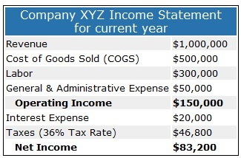
公司财报中的名词是什么意思？
Sales (=(Gross) Revenue = operation profit)
Total amount earned from sales
Net sales (=net revenue)
= gross revenue 减去 all product-related costs
Net profit (=net income)
可以是负的
= net sales 减去 all costs, 包括tax等
公司可以决定把一部分net profit分给持股人(pay dividend to stockholders)，然后把其他的reinvest到business里去
Operating expense (简称OPEX)
包括rent, equipment, inventory costs, marketing, payroll, insurance, research fee, etc.
Operating profit (= operating income)
= operating revenue 减去 cost of goods sold 减去 operating expense 减去 depreciation 减去 amortization(折旧)
并不包括tax
公司财报里面经常出现net sales，operating profit，net profit三个数值
右上是一例子，
net income = operating income – interest expense(interest of borrowed money, etc) – tax
公司财报(financial statements)中一般有3个sections：
Balance sheet，包括assets和liabilities
Total Assets: = current asset+otherassets+property and quipment, cash, computers, cars, etc.
Total Liabilities: =current+long-term+deffered income taxs, loan
Income statement, 公司怎样挣钱花钱的
分income和expenses
Net income, 主要看这个，如果不能每年稳定增长就不要投
Cash flow statement
在net income的明细中，会有income具体从哪里来的
除了net income还有其他，比如financing activities，会列出钱的流动
一个好的公司应该有high net income growth, high level of assets relative to liabilities, 和high degree of cash inflows
TOPIX: Tokyo stock price index、東証１部のすべて銘柄の平均
日経：東証１部の225銘柄の平均

Slide 6
What Stock Markets Are (这个解释蛮简单，但引出一个新问题，为什么把share拿出来卖？)
Before you can understand why stock markets rise and fall, you need to understand what a stock market is. A stock market is a place where people come together to buy and sell ownership shares in a company. The value of a company, or its market capitalization, is the sum of all the ownership shares it has outstanding multiplied by the price of those shares. For example, Apple, Inc. (AAPL
) has 5.13 billion shares that trade at $178 a share as of January 2018—therefore Apple is worth $913 billion. (See also: Stocks Basics Tutorial.)
公司的Stock price是怎么定的？
The next piece to understand is what a company’s value represents. A company has stuff and it sells stuff. The stuff it has—buildings, machinery, patents, money in the bank, etc.—constitute its book value, or the amount of money a company would get if they sold all of that stuff at once. But companies are primarily in business of trying to make a profit, and in doing so they earn cash by selling products or services. So the value of a company has to do with the stuff it owns now and the cash flows it will receive in the future. The value of the stuff it owns now is fairly easy to determine, but the value of all the future cash flow streams is a bit trickier to nail down—and it is this piece that is responsible for market gyrations.
Cash Flows and Price-to-Earnings (P/E ratio的易懂解释)
Once an appropriate discount rate has been estimated, the hard part is to figure out what future cash flows will be—a month from now, a year from now, five years from now. Financial analysts try to figure these amounts out in a number of ways accounting for both company-specific factors and macro factors such as overall economic health. Fortunately, the stock market reflects the expectation of future cash flows in an easy to compute ratio of price to earnings, also known as the P/E ratio. A P/E ratio of 10x means that a company is being valued today at 10 times its current earnings. A P/E ratio of 20x for the same company would mean that given the same amount of earnings, the market is giving it twice as much value, indicating that those future cash flows are going to be larger.
So that’s basically it: stock markets are places where people buy and sell shares of companies, and these shares are valued in large part as a multiple of current earnings that represent the net present value of future cash flows. Because the future is unknown today, various peoples’ estimates will be different from one another, giving some a higher expected stock price and some a lower stock price. If the current price is lower than the expected price, people will buy it. If it is higher, people will sell it. And this is the stock market.

Slide 7
Additional Reading: A case study of stock market
Why Stock Markets Fall—And Why They Fell in Early 2016
When an economy is growing, people are spending and profits are rising. Companies invest in projects, expand their businesses and hire more people. Investors are optimistic and expectations of future cash flows rise, and stocks enter a bull market.
Simply put, stock markets fall when expectations of future cash flows decrease, making the prices of companies seem too high, therefore causing people to sell shares. If many more people come to this decision than there are people to buy those shares, the price will fall until it reaches a level where people will begin to believe that they are fairly valued.
China, Actually
Let’s look at China. A lot of the blame for the 2016 global market declines was related to weakness in the Chinese economy and a crash in Chinese stocks. Weak demand from China not only reduced expected future profits from Chinese companies but also from global corporations who do business with China, and this has a ripple effect. American companies that produce commodities or products that are exported to China see lower earnings. American banks that lend to those companies see their profits fall as those loans become more risky. Expectations about future cash flows fall and stock prices will follow suit. (See also: China’s Stock Markets vs U.S. Stock Markets.)
China’s stock market rose dramatically over the years leading up to 2016 as investors believed that Chinese economic growth would keep on expanding at a rapid pace. The average P/E ratio for the Shanghai market rose to around 50x earnings, and the tech-heavy Shenzen index rose to a P/E of over 100x. The P/E ratio for the Nasdaq composite before the dot-com bubble burst was as high as 175x in March 2000. To put this into perspective, the average P/E ratio for U.S. stocks historically has been around 15.6x.
In order to restore more realistic P/E ratios based on more realistic expectations of growth and future cash flows, stock prices needed to fall. And they needed to fall until that ratio begins to make sense.
We also had a very low interest rate environment for a record amount of time, which made borrowing cheaper and easier for companies to expand their operations. Low interest rates, however, can cause them to take on too much risk and expand more rapidly than is justified. When the Federal Reserve began raising interest rates in December 2015, the cost of borrowing increased and took a bite out of profits, reducing future cash flows. Rising interest rates also have the effect of increasing the rate used to discount cash flows, making $1 earned next year worth less today than given a lower rate of interest.
Another factor is that people are not always rational—especially when it comes to money and investments. Rather than an orderly drop in price to restore some fundamental level of price to earnings, people often overreact and panic. When there is panic, there is fear, irrational behavior spreads and markets collapse. Expectations about future cash flows essentially drop to zero and people become more concerned with converting investments into cash as quickly as possible.
The Bottom Line
Of course, panic doesn’t last forever, and ultimately smart investors see oversold price levels as buying opportunities when company values go “on sale."

Slide 8
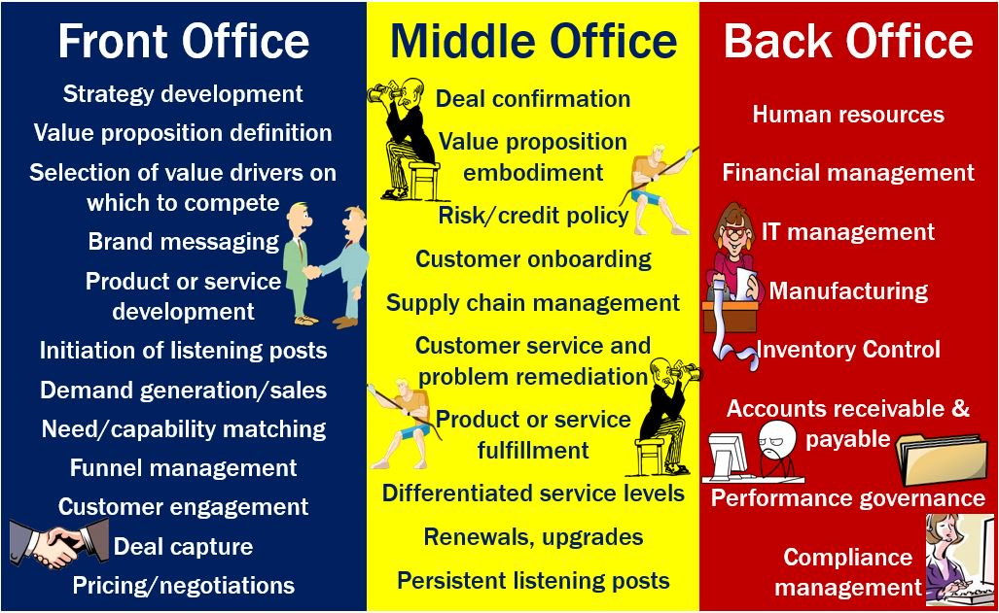
Something about finance,
FICC (Fixed Income Currencies and Commodities): 更大的范畴是Fixed Income securities，比如说bonds。A bond is an investment product that is issued by corporate and governmental entities to raise capital to finance and expand their operations and projects. The borrower, or issuer, promises to pay interest, called the coupon, on an annual or semi-annual basis until a set date. The issuer returns the principal amount, also called the face or par value, to the investor on the maturity date.
Underlying: 在股票而言，就是当前该股票股价；更加广义而言，就是影响一个financial asset价值的因素
Asset vs. derivatives: 正常股票买卖是asset，derivatives是指某些基于asset的买卖，比如future contract。比如一个人A有100股Pana的股票，现在价钱100元每股；A害怕Pana股票会跌，但有一个人B觉得Pana股票会涨；A和B可以结成一个future contract，约定一年后，不管Pana股票会怎么变动，B都会以每股105元的价钱从A买走全部股票；这样的话比如一年后Pana股票涨到120元，B就可以以很低的价钱买走A的股票。
Synthetic: ?
Financial instrument: cash, equity等
Appreciate: finance用语，表示价格涨了，比如股价涨了
Depreciate: 股价跌了
OTC: Over the Counter, 有些小公司没有被列在NYSE等大index上，OTC为这些小公司提供股票交易平台; 非处方药也是OTC，不用大夫开，直接可以买

Slide 9
Funds分类:
一般分为两类，Hedge Fund和Mutual fund
Hedge fund: 汉语名应该叫私募，也叫对冲基金
就美国而言，没有被SEC管理
用的technique和mutual fund不同，经常借钱买卖股票，以使收益最大化 (这技巧叫leverage)
经常投资 derivatives
一般是“死期投资”，不能随时出入fund (比如说一投就是5年)
能入hedge fund的一般是很有钱的人或者institutes
Mutual fund: 就是一般基金，根据策略可细分为index fund, balanced fund
从散户收集资金
每天计算mutual fund的share price，可以随时出入
被SEC管理，投资种类有限定，比较稳妥的是投government/cooperate bonds和买index中所有股票
现在先理解到这，之后有需要再详细查。
关于share和shareholder
一般公司issue 2 types of stocks: common stock, preferred stock
一般散户都卖的是common stock，因为跟家便宜，发行数量也多
Preferred stock的shareholder会收到fixed dividends (一般来说不少)，preferred stock的price也less volatile；但有一点，preferred stock shareholder并没有voting的权利
Shareholder根据持有股票的数量的不同，拥有的权力也不同
Majority shareholder: is a person or entity that owns and controls more than 50 percent of a company's outstanding shares
Outstanding share的意思是，公司发行的股票share中，已经被买了的部分
Share也有3个class，不同公司会用不同class来实现不同目的，以Google (alphabet)为例
Class A: hold by regular investors, 1 vote per share
Class B: hold primarily by founders (Brin and Page), 10 vote per share
Class C: hold by employees, no voting right
综上所述，share的class不同主要就是voting right的不同

Slide 10
Buffett Indicator:
Aka. Market cap to GDP ratio
To assess whether the country’s stock market is overvalued or undervalued (这是一个用来评价一个国家的股票市场的指标，似乎也有用来评价一只股票的类似指标)
= (value of all public stocks in a country) / (gross domestic product of a country)
The numeric meaning:
~ 50%, stock market too low
75%~90%, stock market is just about right
115%~, overvalued
Price-to-Sales Ratio (P/S ratio)
和Buffett indicator比较相似，用来评价一只股票是overvalued还是under
A indicator of the value placed on each dollar of a company’s sales or revenues
used to compare companies in the same sector. A low ratio may indicate possible undervaluation, while a ratio that is significantly above the average may suggest overvaluation.
Usually calculate based on yearly sales,
E.g., if a company’s yearly sales is $455 M, this company has 100 M shares, and is trading at $10, then P/S = 10 / (455M/100M)= 2.20
TMT (technology, media, and telecommunication):
有些venture capital (VC)投资公司会标明自己的投资方向，TMT就是方向的其中之一
也有可能叫TMC (,, communications)
TMT sector的特征是
heavily depend on R&D, patent和其他intellectual property protections
一般有rapid company growth
从股票上来看，投资者们会tolerate relatively high P/E ratio
TMT中的小分类有，有些大公司业务很多，会存在于多个小分类中
Semiconductor manufacturers, e.g., AMD, intel, Nvidia, etc.
Telecom (Phone, TV, internet), e.g., AT&T, Verizon, Sprint, etc.
Hardware makers, e.g., IBM, DELL, phone makers, etc.
Internet companies, Facebook, Groupon, LinkedIn.
Software companies, Microsoft, Adobe, SAP
Networking companies, Cisco
Media companies, social media

Slide 11
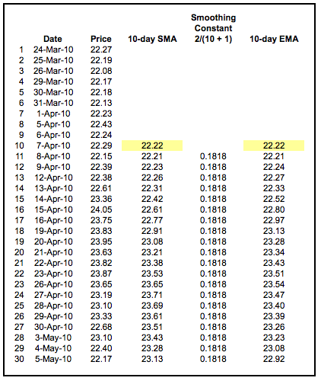
SMA (simple moving average)
经常用 n-day SMA来评价在一定期间的average
计算方法，需要某只股票我有100天的closing price，当要计算5-day SMA时，
从第5天开始，抽出前5天(包括今天)的closing price，sum之后除以5，就是第一个5-day SMA
从第2天开始，抽出前5天(包括今天)的closing price，sum之后除以5，就是第一个5-day SMA…
如此重复
SMA可以用来indicate “lagging”, 或者说用来“预测”将来几天股价走向
EMA (exponential moving average)
相比SMA，EMA assign more weight to recent prices，也一般是对closing price算
EMA似乎最常用于 forex trading (外汇交易)
常用的是12-day和26-day的EMA for short term; 50- and 200-day EMA for long term
我的理解是，EMA的斜率可以预测股票price的变化，e.g.,如果EMA斜率变从陡峭得平缓，则意味着price要从大跌/大升变稳定
MACD (moving average convergence/divergence oscillator):
关于怎样计算，看我的另一个repo “StockCracker”, 以及ref PDF
MACD有2条线，MACD线(=12-day EMA – 26-day EMA)和signal线(=以9-day为period，对MACD算EMA)
主要是看这两条线互相crossover来决定买卖的timing，crossover point重要
还有MACD的正负也很重要，MACD>0的时候，说明12-day EMA > 26-day EMA, 换句话说price上升的momentum在增加；反之price下降的momentum增加
OBV (on balance volume)
On-balance volume (OBV) is a momentum indicator that uses volume flow to predict changes in stock price.
OBV的有效性是因为有institutional investors和retail investors (就是fund和散户)，institutional investor比较聪明，在某只股票low price的时候以非常大的volume买进，这个大量volume会使price high (散户一般是这时候才买进的，肯定亏)
记住这点 volume drives price
计算方法很简单，是
Initial OBV = 0
然后看股票第二天是升了还是跌了，升的话 OBV+第二天的volume；跌的话OBV-第二天volume
对第三，四，…, 重复2
StockCracker repo中已经实装了，参考那
10-day EMA的第一天的值，就是那天的10-day SMA

Slide 12
Startup公司的ABC轮(英语是serial A, B, C)啥时意思？
Venture round: venture round is a type of funding round used for venture capital financing, by which startup companies obtain investment
venture capital financing: private equity capital provided as seed funding to early-stage, high-potential, growth companies
A,B,C和字母表顺序没什么关系，但是与公司的development stage有关系 (或者说maturity levels of the business)
公司决定进行A，B，C轮的原因可能是只依靠自己口袋里的钱的话已经不够了，需要外部investor
再每一轮之前，都会有一个valuation of the company, 这个valuation包括management, proven track record(?), market size, risk.
再ABC之前，会有seed轮，筹集到的钱一般用来support initial market research and development；在这一轮之前，很多entrepreneurs都work alone or with a few partners；他们可以用这一轮拿到的钱launch their product
这一轮的investors一般是risk-loving types
这一轮公司能筹到的钱一般是50~200万美元
A轮，在公司有一定的track record之后，可以参加这一轮并用筹到的钱来optimize product and user base；对公司而言，一定要有business model (for long-term profit)
这一轮的investors一般是traditional venture capital firms (e.g., Sequoia, Benchmark, Greylock, Accel, etc.)
这一轮公司可能筹到的钱是200~1500万美元
B轮(build)，公司可以用这一轮的钱来expand market reach (e.g., bulk up on business development, sales, advertising, tech, support, etc.)，经过前两轮，一个公司的value就更好评价了
这一轮的investors一般是和A轮相似
这一轮公司能筹到的钱一般是700~1000万美元
C轮(scale), successful的公司可以得到investor的青睐，这些成功的公司可以筹钱来perfect产品和扩张，或者用来买其他competitor
这一轮的investors有很多，hedge funds, investment banks private equity firms, etc. 因为公司已经less risky了
这一轮公司可能筹到的钱也说不定，从几百万到几亿美元

Slide 13
怎样写Business Plan:
有word的template，需要的包括的内容一般有
Executive summary
一般2 pages, 概括最重要的aspects (e.g., business concept, major achievement, current business position, etc.)
General company description
1~2 pages, 公司名, ownership, assets, goals and objectives, core competencies, etc.
The opportunity, industry and market
2~3 pages,
Opportunity: where is the gap in market?, how is it identified?, etc.
Industry: barriers to entry the industry?, competitors and their strength?, major factors affecting the industry?, etc.
Market: total size?, market growing?, my share of the market?, major trends in market?, etc.
Strategy
1~2 pages, focus on business is mass market or else?, how will I succeed (my actions in detail)?, my business uniqueness?, etc.
Business model
1 page, source of revenue, major costs, profitability, investment required (to get business running and to scale), critical success factors, etc.
Team – management and organization
2 pages, list of founders and their experience, a description of who will manage what.
Marketing plan
2~3 pages, product why valuable to customer?, detail description of target market, how customer will perceive my product?, pricing strategy, sales and distribution channels, promotion strategy and advertising.
Operation plan
2 pages, description of operation cycle (what the company will do to sell the product), necessary skills and materials, what will be outsourced.
Financial plan
2~4 pages, start-up expenses (details on what it will cost to launch), 12-month profit and loss projection (month by month) + 3-year projection (quarter by quarter), 12-month + 3-year cash flow projection, projected balance sheet (reports a company's assets, liabilities and shareholders' equity)
Appendix,
Additional info, advertising materials, blueprints and plans, industry/market studies, list of assets, etc.

